Slide 1


SQL LIBRARY DATABASE PROJECT
Comprehensive Analysis and Structured Queries
Presented by:
Fouzia Kouser

Slide 2

Project Overview: Library Database Management System Analysis with SQL
This project delves into the world of library management systems by utilizing SQL queries to extract and analyze relevant data.
OBJECTIVE:
Develop and execute SQL queries to retrieve and analyze information from a library management system.

Slide 3

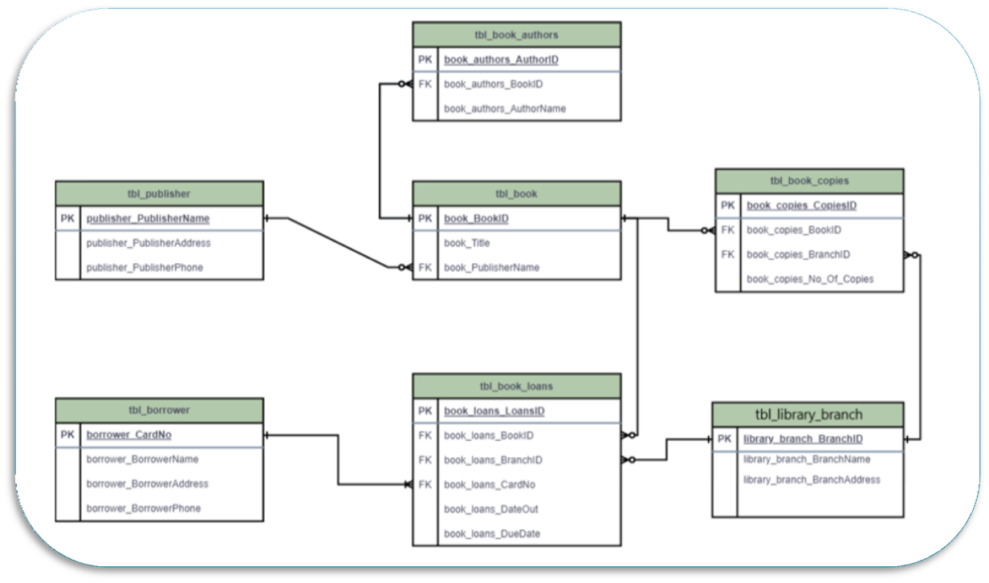
Data Model

Slide 4
The data model consists of several entities:
Borrower: Represents a person registered with the library who can borrow books.
Book: Represents a written work in the library's collection.
Library Branch: Represents a physical location where books are stored and loaned to borrowers.
Book Copy: Represents a physical copy of a book owned by a specific library branch.
Book Loan: Represents the borrowing of a book by a borrower from a specific library branch.
Author: Represents the person who wrote a book.

Slide 5
Relationships between entities:
A Borrower can borrow many Book Copies (one-to-many).
A Book Copy belongs to one Library Branch (one-to-many).
A Book Copy is a copy of one Book (one-to-many).
A Book can be written by one or many Authors (many-to-many).
A Book Loan involves one Borrower and one Book Copy (many-to-many).
A Book Loan is associated with one Library Branch (one-to-many).

Slide 6
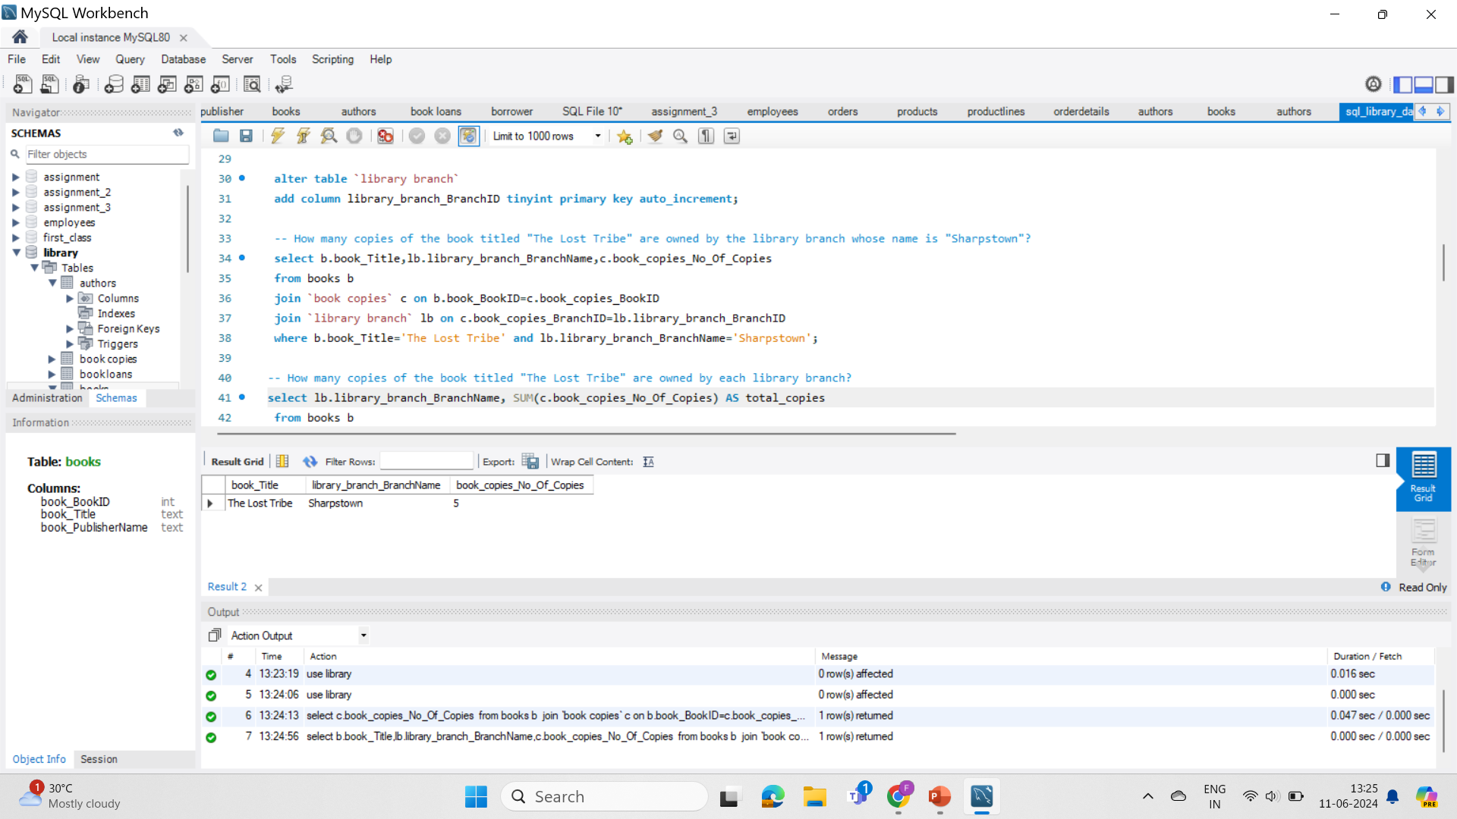
QUERY:
How many copies of the book titled "The Lost Tribe" are owned by the library branch whose name is "Sharpstown"?
Let us see
This query retrieves the number of copies of the book "The Lost Tribe" owned by the "Sharpstown" library branch.

Slide 7
Result:
"Sharpstown" library branch has five copies of the book "The Lost Tribe" in its collection.

Slide 8
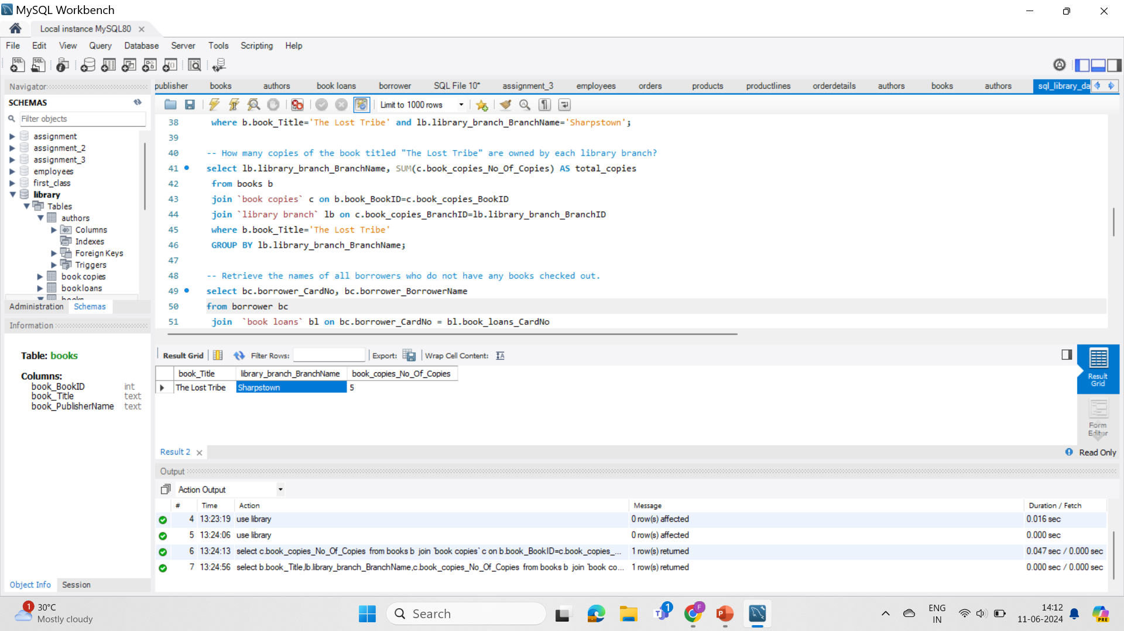
How many copies of the book titled "The Lost Tribe" are owned by each library branch?
This query retrieves information about all copies of the book "The Lost Tribe" across all library branches.

Slide 9
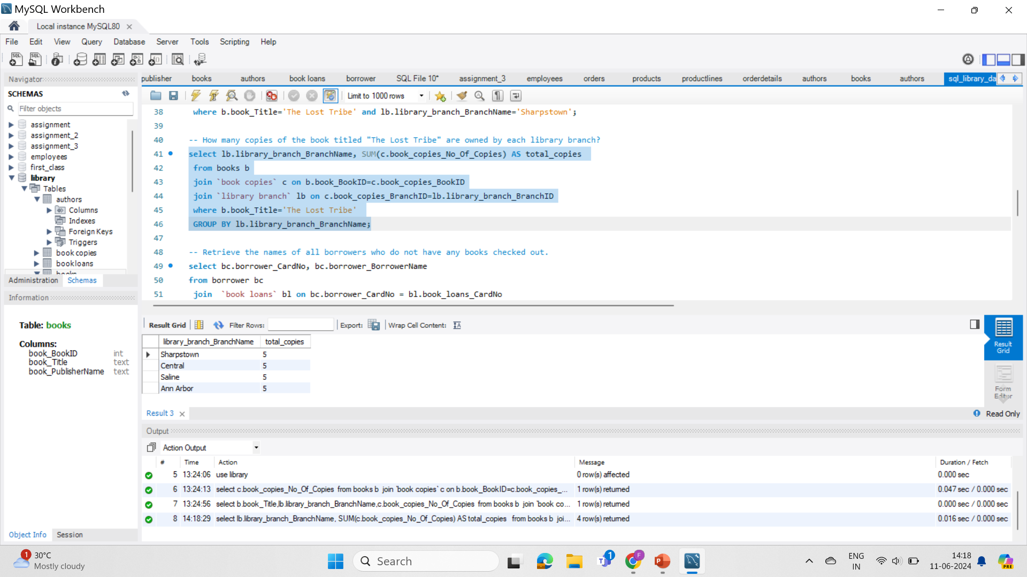
Each library branch ("Sharpstown", "Central", "Saline", and "Ann Arbor") has five copies of the book "The Lost Tribe" in its collection.

Slide 10
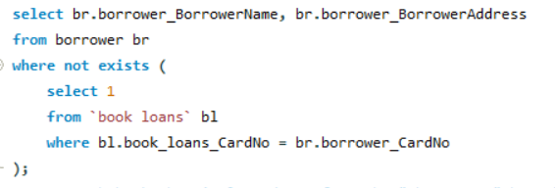
Retrieve the names of all borrowers who do not have any books checked out.
Finds borrowers with no checkouts: uses subquery to check for missing loans.

Slide 11
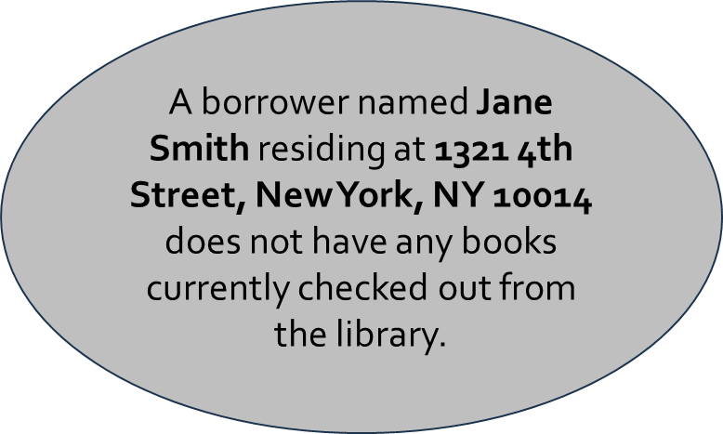
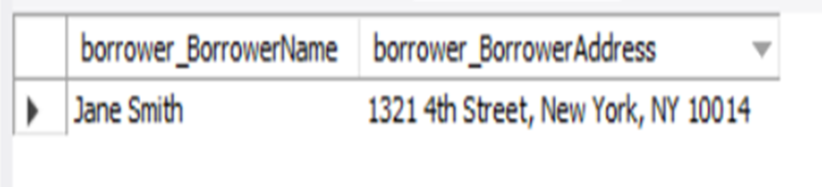

Slide 12
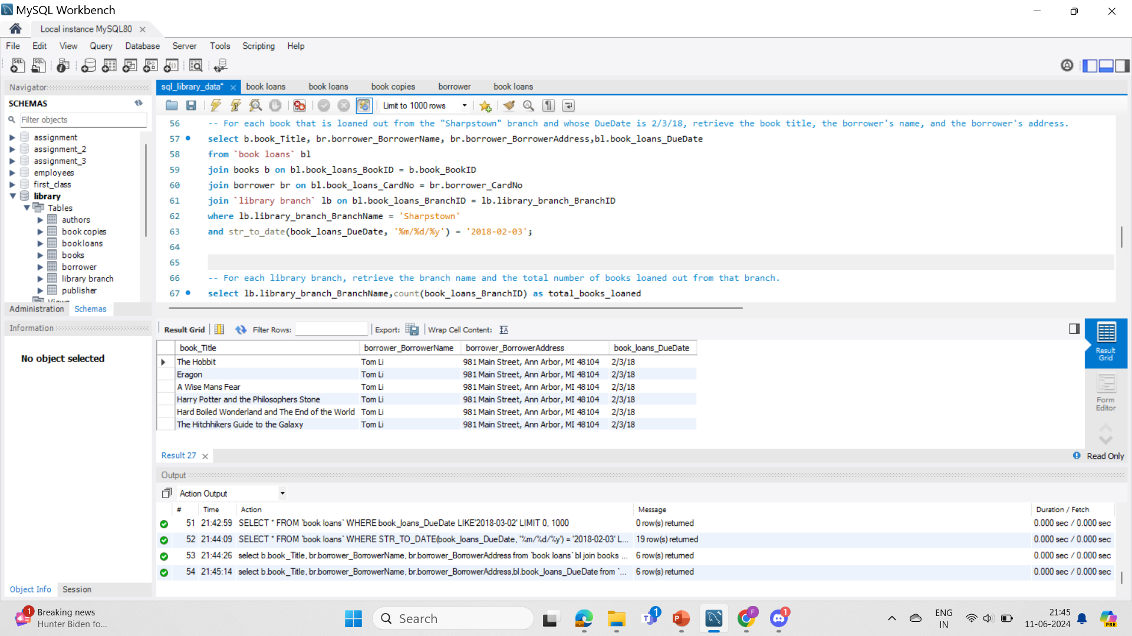
For each book that is loaned out from the "Sharpstown" branch and whose DueDate is 2/3/18, retrieve the book title, the borrower's name, and the borrower's address.
This query retrieves overdue books (due date 2/3/18) loaned from "Sharpstown" by joining book, borrower, book loan , and library branch tables.

Slide 13
The output lists six overdue books (due date 2/3/18) borrowed by Tom Li from "Sharpstown" branch.

Slide 14
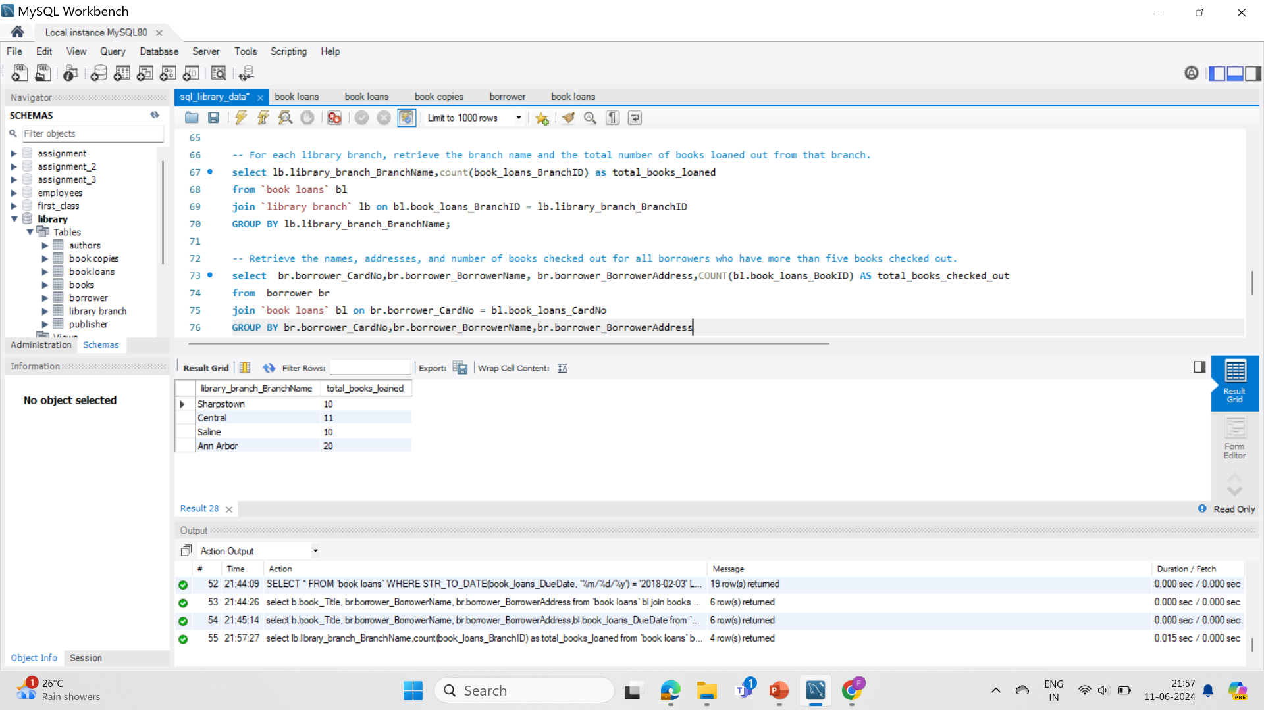
For each library branch, retrieve the branch name and the total number of books loaned out from that branch.
This query groups loaned books by branch using GROUP BY and counts them for each branch name using count to show total loans per branch.

Slide 15
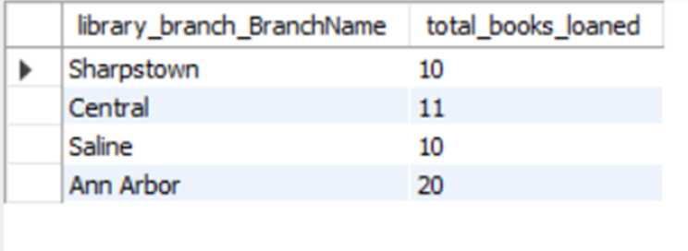
The total number of loaned books for each library branch: 'Sharpstown' (10), 'Central' (11), 'Saline' (10), and 'Ann Arbor' (20).

Slide 16
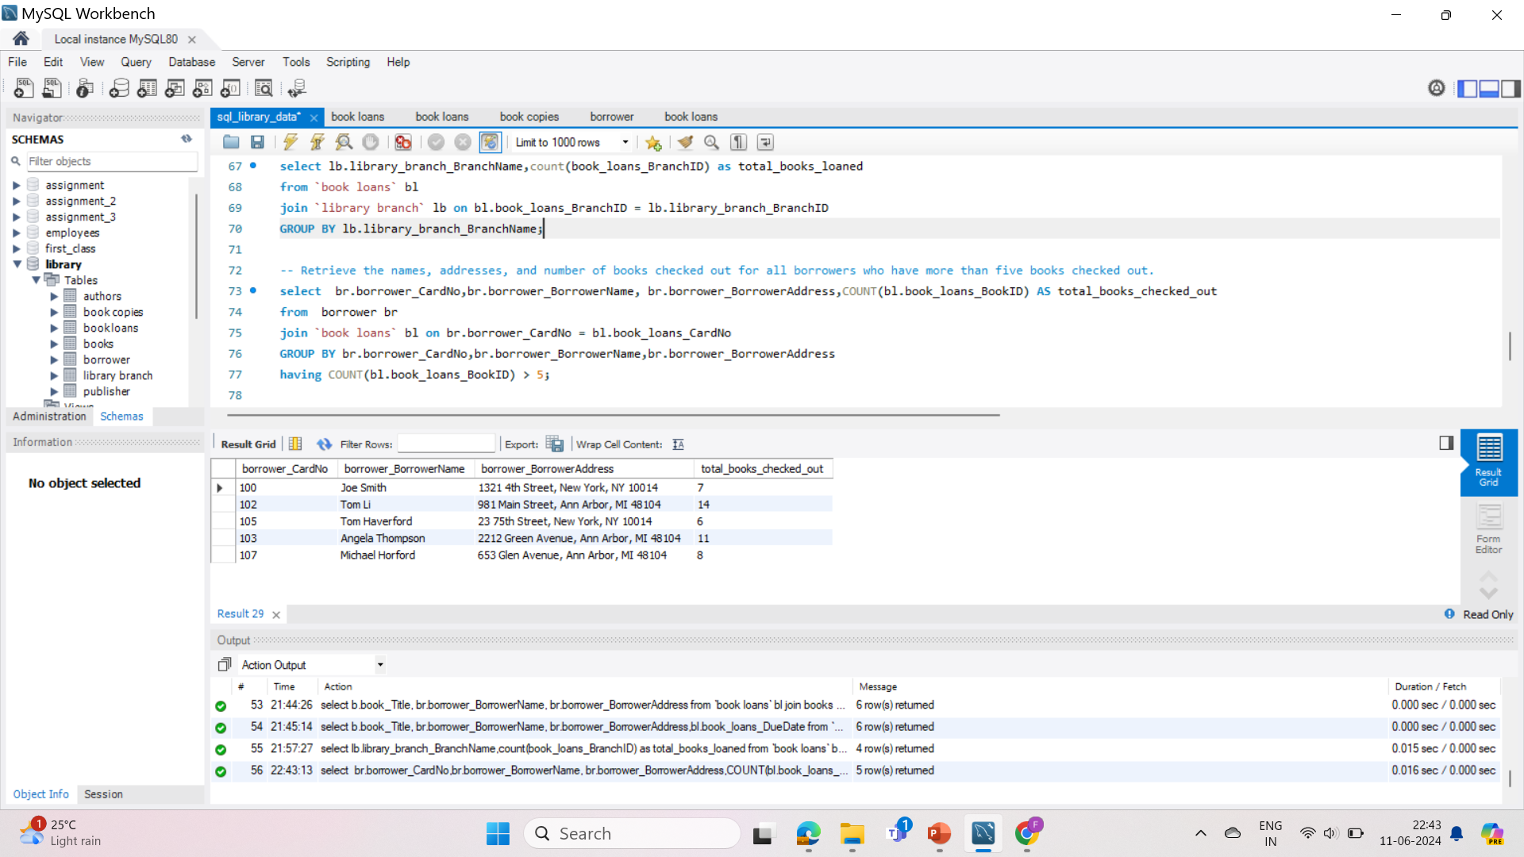
Retrieve the names, addresses, and number of books checked out for all borrowers who have more than five books checked out.
This query finds borrowers with over 5 checkouts by joining borrower and book loan tables, grouping by borrower info, and filtering with a having clause on book loan count.

Slide 17

Lists borrowers with >5 checkouts: names, addresses, & book counts.

Slide 18
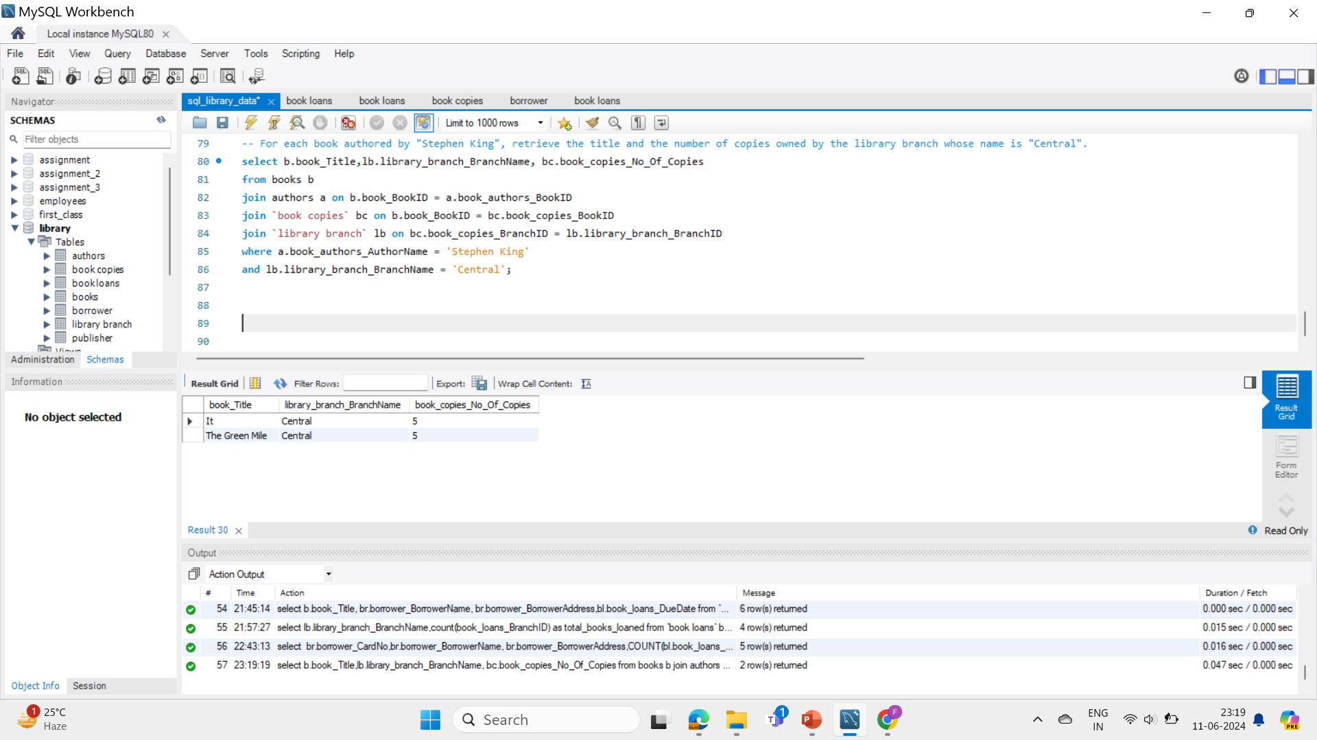
For each book authored by "Stephen King", retrieve the title and the number of copies owned by the library branch whose name is "Central".
This query retrieves Stephen King book titles and their corresponding number of copies at the "Central" library branch by joining books, authors, book copies, and library branch tables.

Slide 19
Lists Stephen King books ("It", "The Green Mile") and the number of copies ("5" each) owned by the "Central" library branch.

Slide 20

Conclusions
This project successfully demonstrated the power of SQL in extracting and analyzing data from a library management system. By crafting various queries, we were able to gain insights into book availability, borrower activity, overdue materials, and author representation within the library's collection. These insights could be valuable for library staff in tasks such as collection management, identifying popular books, and understanding borrower behavior.

Slide 21

Thank You!

